Slide 1

DOTGROUP https://dot2025.top/static/explore
MISSION
Bridging the Gap Between the POOR and the RICH
VISION
Empowering a Global Community of Unlimited Possibilities
SLOGAN
Let's DO it together!
VISIT
https://dot2025.top/static/about

Slide 2
DOTGROUP https://dot2025.top/static/explore
ECOMMERCE PLATFORM
SOCIAL MEDIA PLATFORM
ELEARNING PLATFORM
ASSOCIATE PROGRAM
presents

Slide 3
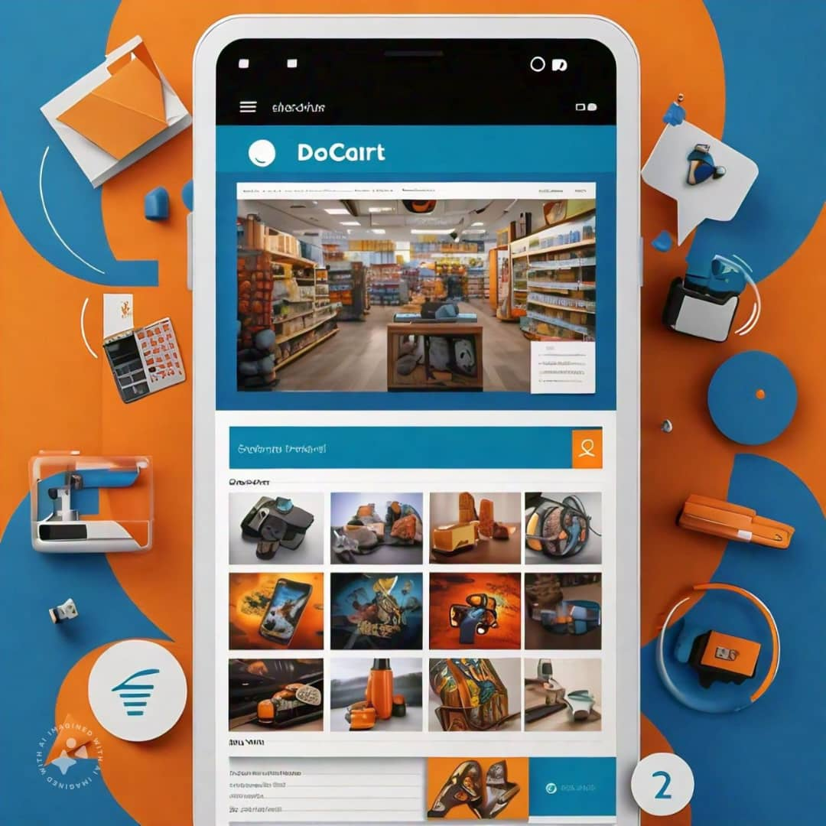
ECOMMERCE
DoCart: Centralised Access Retail Terminal
BEST SELLERS REWARDED: Recognize and reward top-selling vendors
LOYAL BUYERS APPRECIATED: Reward frequent and high-value customers
SCAM-FREE GUARANTEE: Secure and trustworthy transactions
TRANSPARENT MARKETPLACE: Verified seller profiles and customer reviews
QUALITY PRODUCTS: Wide range of authentic products
Competitive Prices
Timely Delivery
24/7 Customer Support
Trusted payment method

Slide 4

SOCIAL MEDIA
DoChatUp: Community Hub For Advancement and Transformation
ENGAGE AND EARN: Like, comment, post, and grow your Capital Wallet
REWARDING INTERACTIONS: Get rewarded for comments, likes, and shares
BLOGGER OF THE YEAR AWARD: Recognize and reward top content creators
COMMUNITY DRIVEN: Connect, share, and collaborate with like-minded individuals
SAFE AND SECURE: Moderate and spam-free environment
Influencer Opportunities
Exclusive Content
Real-time Updates
Gamified Experience

Slide 5

ELEARNING
DoLearn: Limitless Education And Resource Network
BENEFITS
Comprehensive training programs
Expert instructors and mentors
Flexible online learning
Certificate upon completion
Automatic employment with DOTGROUP
$100 monthly stipend for employed candidates
Opportunities for career advancement
COURSE STRUCTURE
1. BASIC CLASS: Foundations and essentials
2. INTERMEDIATE CLASS: Skill development and enhancement
3. ADVANCED CLASS: Expertise and specialization
UNIQUE FEATURES
Access to 5+ expert tutors for each course, skill, or subject
Diverse perspectives and teaching styles
Enhanced learning experience through collaborative mentorship
KEY FEATURES
Interactive lessons and quizzes
Real-world project-based learning
Personalized feedback and support
Access to industry experts
Peer-to-peer learning and discussion forums

Slide 6

ASSOCIATE PROGRAM
DEFINITION
Partnering with experts to teach and promote courses, etc
Opportunities for professional growth
Collaboration with like-minded individuals
REQUIREMENTS FOR ASSOCIATES
Expertise in a specific field
Passion for teaching and sharing knowledge
Alignment with company values
BECOMING AN ASSOCIATE
Application process
Onboarding and training
Ongoing support and mentorship
ASSOCIATE BENEFITS
Monthly Salary of $100
Access to exclusive training and resources
Opportunities for networking and collaboration
Recognition and rewards for outstanding performance

Slide 7
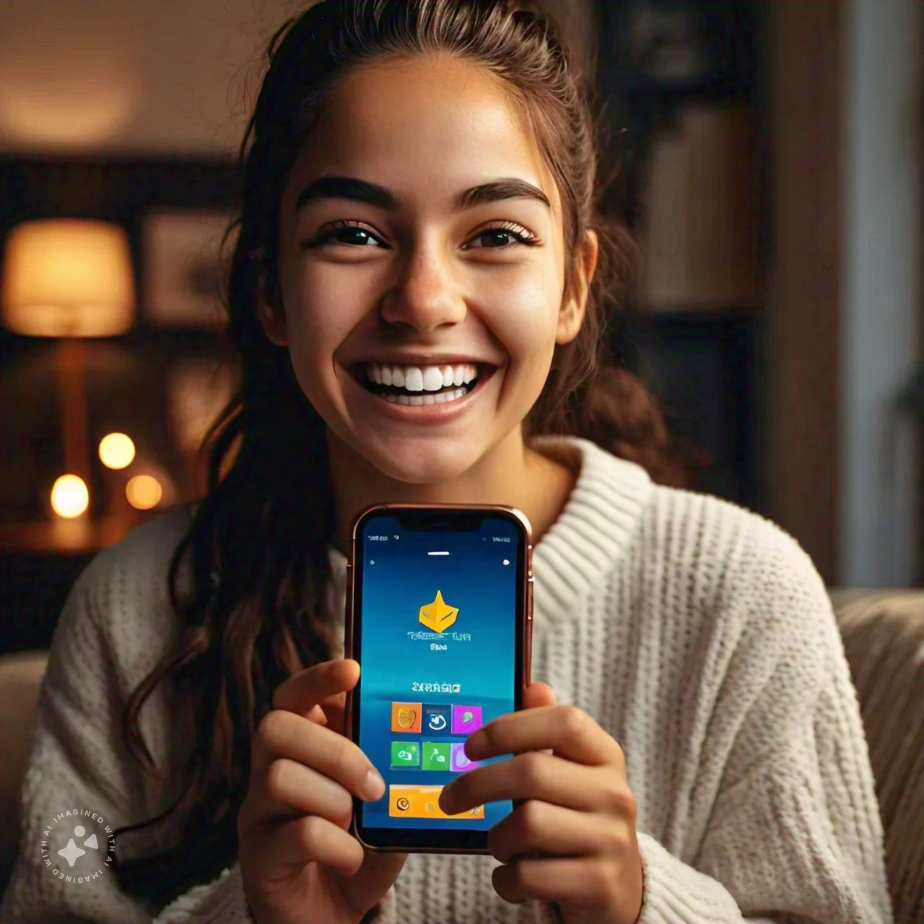
POINT SYSTEM
1000 POINTS = $1
Earning points
Registration: 10,000 points
Referral: 1000 points
Post: 20 points
Post view: 1 point
Commenting: 10 points/5 points
Reaction: 1 point
Follower: 10 points

Slide 8
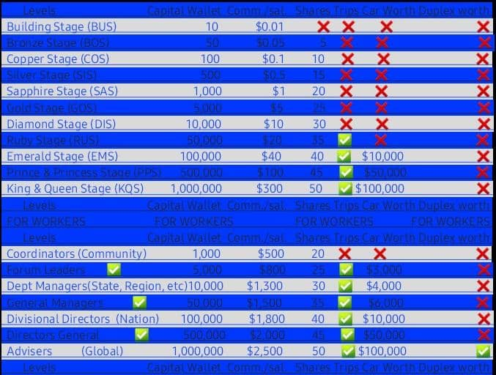
STAGES/CAPITAL STRENGTH/COMMISSION/SHARE
STAGES
BUILDING STAGE (BUS): $10/Nil/Nil
COPPER STAGE (COS): $50
BRONZE STAGE (BOS): $100
SILVER STAGE (SIS): $500
SAPPHIRE STAGE (SAS): $1,000
EMERALD STAGE (EMS): $5,000
RUBY STAGE (RUS): $10,000
GOLD STAGE (GOS): $50,000
DIAMOND STAGE (DIS): $100,000
PRINCE AND PRINCESS STAGE (PPS): $500,000
KING AND QUEEN STAGE (KQS): $1,000,000
PROFIT SHARING
Yearly profit distribution based on the Capital Wallet
The person must be a known person by his local Associate

Slide 9
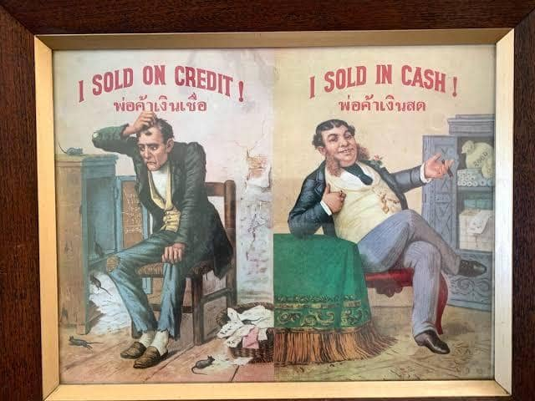
REGISTRATION PROCESS
Before proceeding, make the required payment for account upgrade to:
BANK DETAILS:
FIRST BANK
TARGET VENTURES INTERBIZ
2036341221
OR
FIRST BANK
TARGET VENTURES INTERBIZ
20442959
Sort code; 01115000
Swift code; FBNINGLAXXX
NOTE:
Payment must be made before registration can proceed.
Please confirm with your Associate once payment is made, and they will guide you through the remaining registration steps.
STEP 1: Meet Your Local Associate
Meet with the Associate assigned to your locality to initiate the registration process.
STEP 2: Provide Required Links
Share the following with your Associate:
Referral link
Unique invitation link from your sponsor

